Slide 1

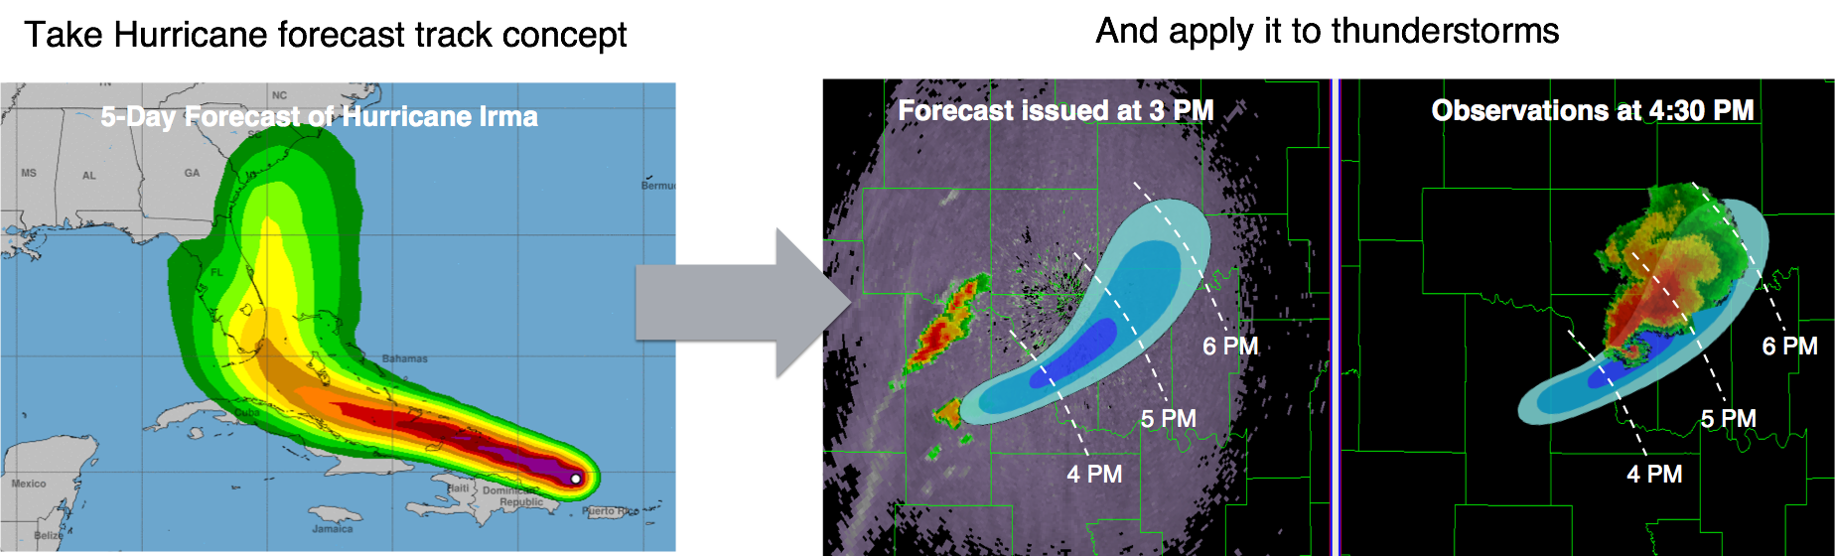
Use Case: Warn-on-Forecast
Overall Goal for Warn-on-Forecast
Adapted from Stensrud et al. 2009
Notes:
- sense of realism and operational urgency – participants use same type of workstations as operational forecasters, issue the same type of products and convective outlooks, and abide by same types of time constraints. For a researcher this can be very humbling, but offers a very realistic perspective of what its like to be a forecaster.
- diverse participants – folks with different backgrounds that don’t normally work together are put in the same room – so many good ideas and potential avenues for research come out of the different perspectives. It also makes the experiment fun and engaging.
- Facilitates two-way R2O and O2R pathways – this means not only are we transitioning tools to operations, we are learning things from forecasters to gear our research to be more operationally relevant.
- lots of quality science results from the experiments

Slide 2
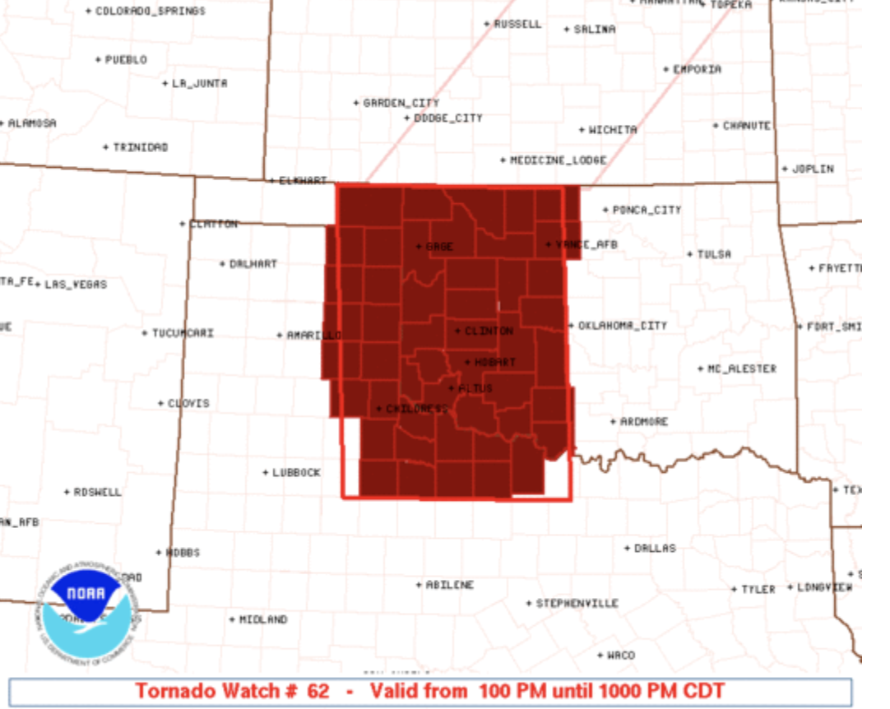
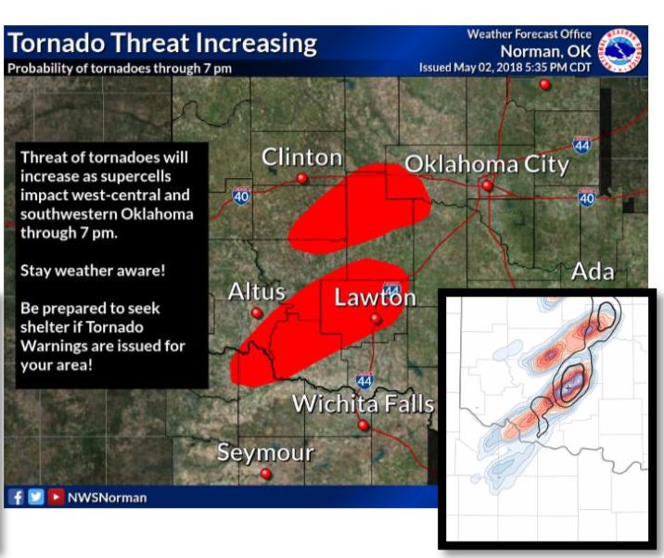
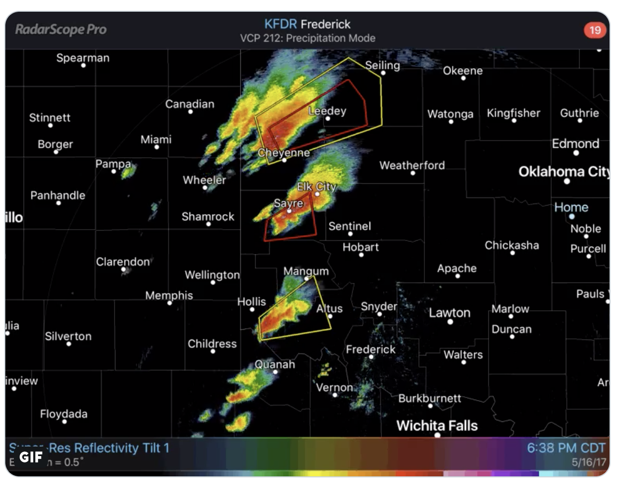
Use Case: Warn-on-Forecast
Current Goal for The Warn-on-Forecast System (WoFS)
There is a gap in guidance between the watch and warning time frames
Tornado Watch
Tornadoes are possible in this area
NSSL’s Warn-on-Forecast
Tornado threat is increasing
Valid for 9 hours
GAP
WoFS provides 0-6 hour forecasts
Valid for 30 minutes
Notes:
- sense of realism and operational urgency – participants use same type of workstations as operational forecasters, issue the same type of products and convective outlooks, and abide by same types of time constraints. For a researcher this can be very humbling, but offers a very realistic perspective of what its like to be a forecaster.
- diverse participants – folks with different backgrounds that don’t normally work together are put in the same room – so many good ideas and potential avenues for research come out of the different perspectives. It also makes the experiment fun and engaging.
- Facilitates two-way R2O and O2R pathways – this means not only are we transitioning tools to operations, we are learning things from forecasters to gear our research to be more operationally relevant.
- lots of quality science results from the experiments

Slide 3
Use Case: Warn-on-Forecast
2020 WoFS Experiment (~ 25 cases)
18 members, 3-km grid-spacing, 900- x 900-km movable domains
1700 – 0300 UTC initializations (XX:00 6-h, XX:30 3-h)
WoFS Datasets
Observations Assimilated
Multi-Radar Multi-Sensor (MRMS) Reflectivity
MRMS Radial Velocity
GOES-16 ABI Cloud Water Path
GOES-16 ABI All Sky Radiances
NCEP Prepbufr
Oklahoma Mesonet (when available)
Background Data
9-member, 31-hour 0600 UTC High-Resolution Rapid Refresh Ensemble (HRRRE) forecast
9-member, 36-hour 1200 UTC HRRRE forecast
36-member, 1-hour HRRR Data Assimilation System (HRRRDAS) forecast
WoFS-Produced Data
36-member WRF boundary files (9-member HRRRE forecast duplicated thrice) from 0600 UTC and 1200 UTC HRRRE
36-member WRF input files (from 36-member HRRRDAS) at initialization time
Every WoFS cycling period (15-min)
36 WRF inputs (following DA), 72 WRF outputs (prior & posterior), Text file w/ info from each assimilated ob
Each WoFS forecast cycle (half-hourly or hourly)
18-member, 5-min WRF history output (limited to pertinent WRF variables)
Notes:
- sense of realism and operational urgency – participants use same type of workstations as operational forecasters, issue the same type of products and convective outlooks, and abide by same types of time constraints. For a researcher this can be very humbling, but offers a very realistic perspective of what its like to be a forecaster.
- diverse participants – folks with different backgrounds that don’t normally work together are put in the same room – so many good ideas and potential avenues for research come out of the different perspectives. It also makes the experiment fun and engaging.
- Facilitates two-way R2O and O2R pathways – this means not only are we transitioning tools to operations, we are learning things from forecasters to gear our research to be more operationally relevant.
- lots of quality science results from the experiments

Slide 4
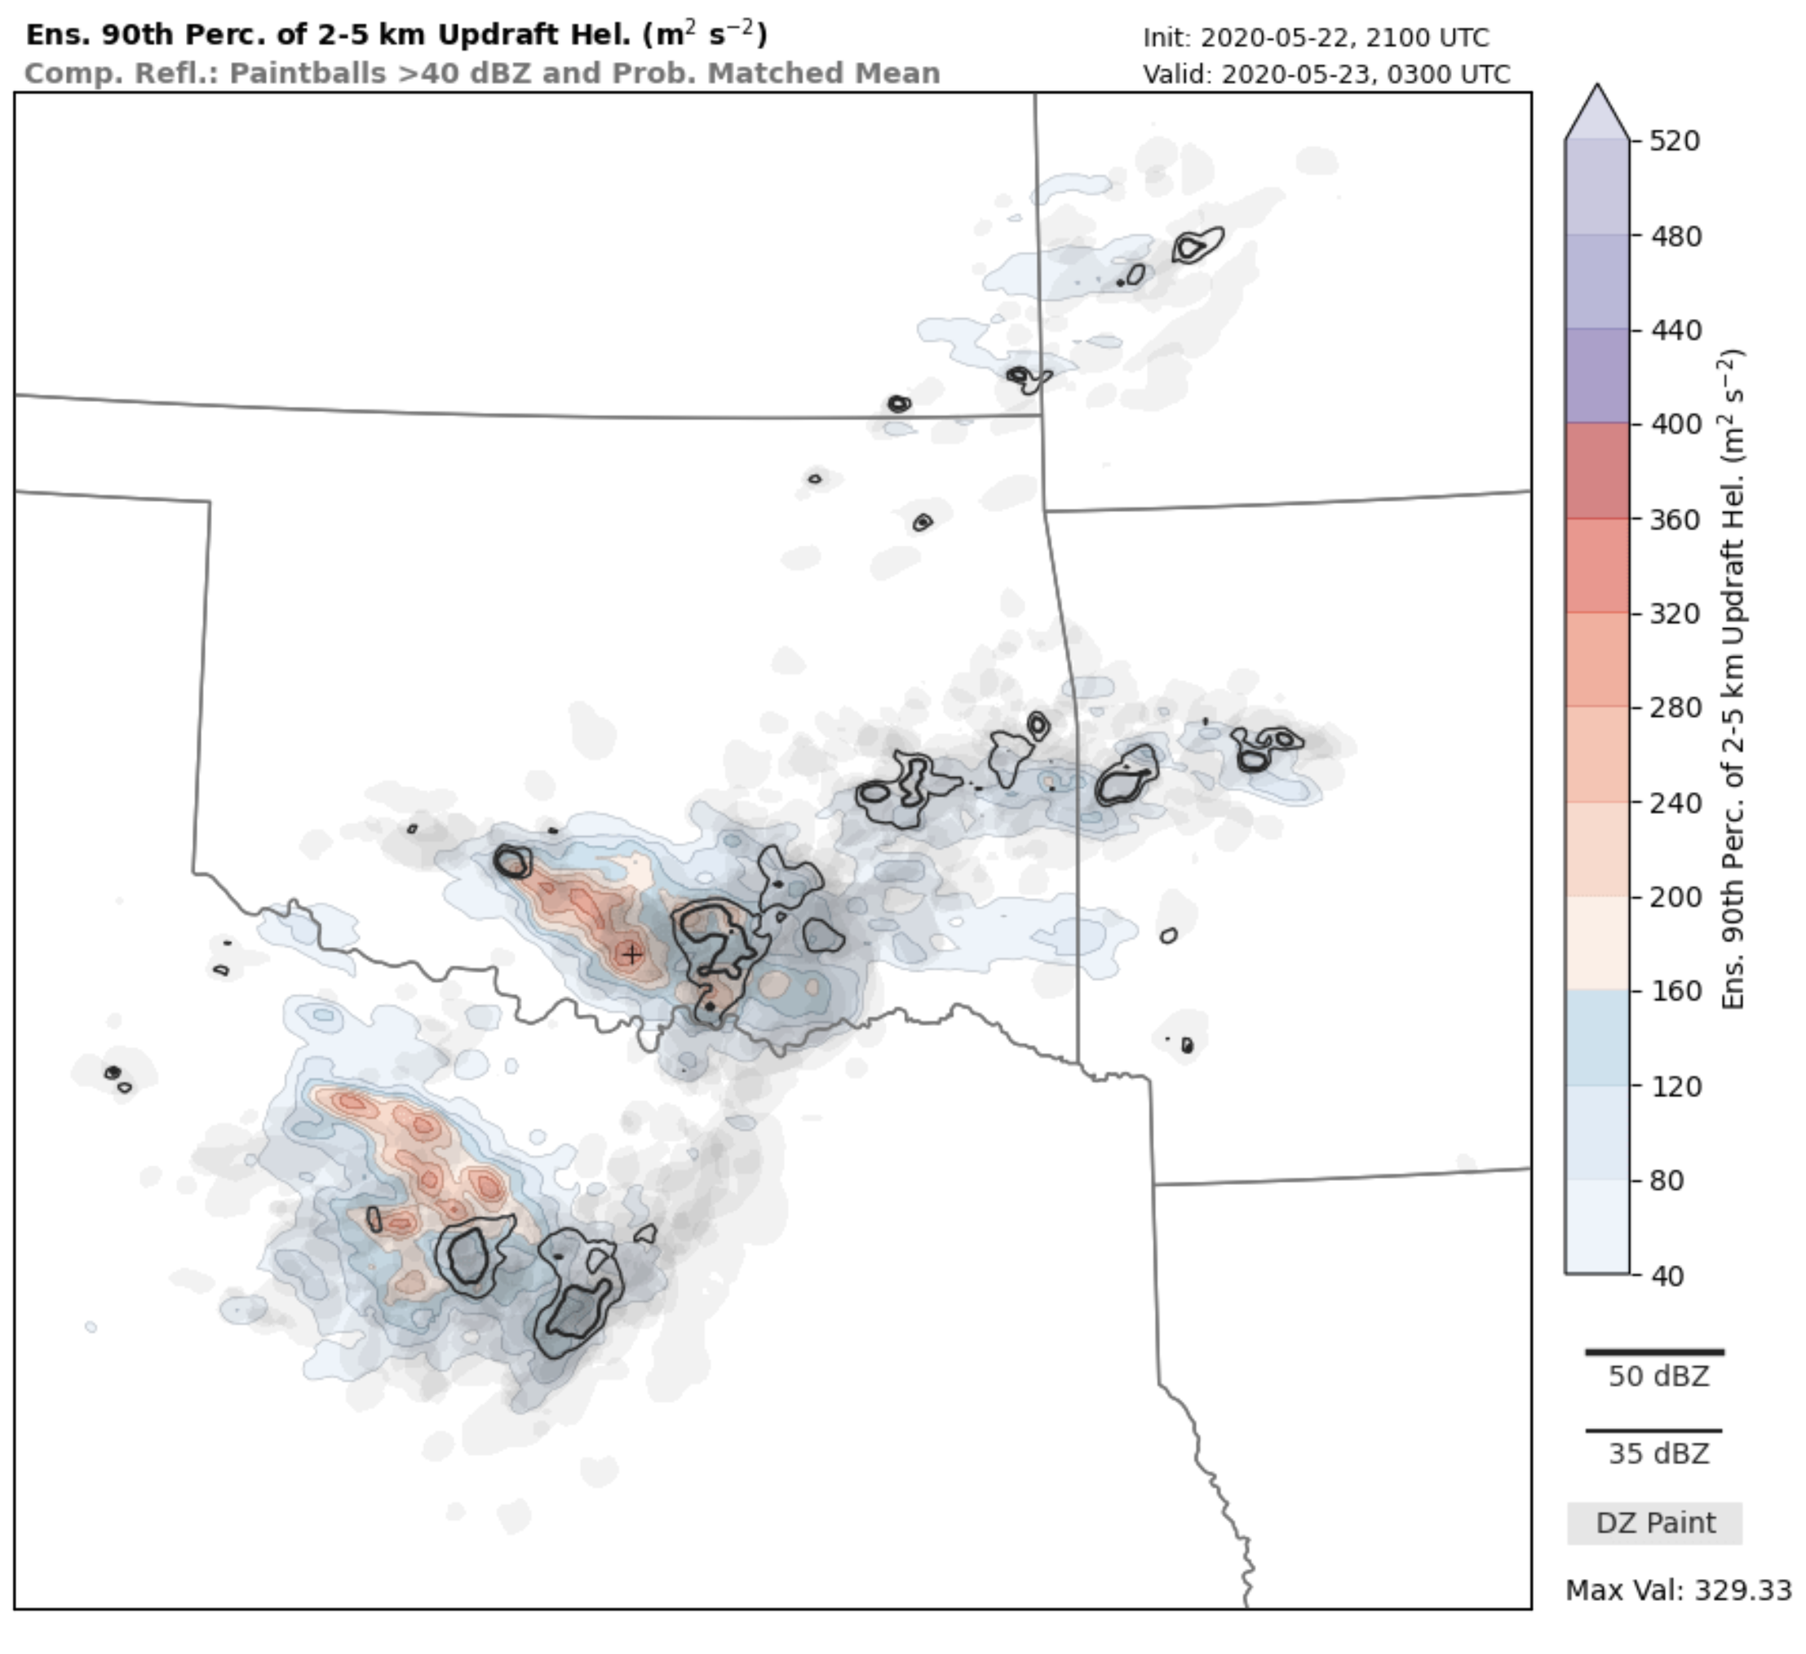
Use Case: Warn-on-Forecast
Post-Processed Data
“Summary Files” - Fields present on WoFS Real-time Viewer
Ensemble Files (storm-scale info)
Environmental Files (environmental info)
Accumulated Swath Files (accumulated ensemble file info)
Half-hourly Swath Files (accumulated ensemble file info each :30)
Hourly Swath Files (accumulated ensemble file info each hour)
Sounding Files (vertical profiles for a 20 x 20 grid across domain)
Web Images (generated from above Summary File output)
~ 21000 .png files per hourly forecast * 14/day
~ 5300 .png files per half-hourly forecast * 10/day
Notes:
- sense of realism and operational urgency – participants use same type of workstations as operational forecasters, issue the same type of products and convective outlooks, and abide by same types of time constraints. For a researcher this can be very humbling, but offers a very realistic perspective of what its like to be a forecaster.
- diverse participants – folks with different backgrounds that don’t normally work together are put in the same room – so many good ideas and potential avenues for research come out of the different perspectives. It also makes the experiment fun and engaging.
- Facilitates two-way R2O and O2R pathways – this means not only are we transitioning tools to operations, we are learning things from forecasters to gear our research to be more operationally relevant.
- lots of quality science results from the experiments

Slide 5
Use Case: Warn-on-Forecast
The Rubric – 6 WoFS Scientists @ NSSL did the scoring
Total: 30 (18-54)
Average: 1.67 (1-3)
Accessibility: Low scores – Ease of Use (1), Model re-usability (1), simulation inputs (1), human effort (1), Platform availability (2), output usability (2), archive accessibility (2)
Community Commitment: Not used in “Highly Influential” assessment (3), but it is a benchmark (1), and it is part of a set (1).
Cost: Computational (2), Storage (3; huge dataset!), transfer cost (2), archiving (2; willingness, but fewer means).
Reproducibility: Difficulty to reproduce details, but findings are robust (2).
Notes:
- sense of realism and operational urgency – participants use same type of workstations as operational forecasters, issue the same type of products and convective outlooks, and abide by same types of time constraints. For a researcher this can be very humbling, but offers a very realistic perspective of what its like to be a forecaster.
- diverse participants – folks with different backgrounds that don’t normally work together are put in the same room – so many good ideas and potential avenues for research come out of the different perspectives. It also makes the experiment fun and engaging.
- Facilitates two-way R2O and O2R pathways – this means not only are we transitioning tools to operations, we are learning things from forecasters to gear our research to be more operationally relevant.
- lots of quality science results from the experiments

Slide 6
Use Case: Warn-on-Forecast
What should we save?
Post-processed output – WoFS is part of a “set” and used as a baseline, so at the least need this saved.
Specific versions of model code, config files, namelists, etc., so DA and forecasts can be replicated.
Assimilated observations and background data
Visualizations & web images – can easily inspect past cases.
WRF input and WRF boundary condition files? Could replicate the model runs w/o having to do all the DA.
What not to save?
Raw model output (i.e., the “wrfouts”)
Questions?
Notes:
- sense of realism and operational urgency – participants use same type of workstations as operational forecasters, issue the same type of products and convective outlooks, and abide by same types of time constraints. For a researcher this can be very humbling, but offers a very realistic perspective of what its like to be a forecaster.
- diverse participants – folks with different backgrounds that don’t normally work together are put in the same room – so many good ideas and potential avenues for research come out of the different perspectives. It also makes the experiment fun and engaging.
- Facilitates two-way R2O and O2R pathways – this means not only are we transitioning tools to operations, we are learning things from forecasters to gear our research to be more operationally relevant.
- lots of quality science results from the experiments

